Slide 1

MSc. Internship Presentation
Efficient Detection of Denial of Service (DoS) attack using Machine Learning
Somesh Saxena
x18176895

Slide 2

Introduction
As the use of internet increases so as the threats are growing just proportionally. One such threat is DoS attack that uses service requests to disrupt computing and its network, leading inability to access websites and data to legitimate users.
The paper deals with the detection of DoS attacks using Machine Learning algorithm’s in an efficient way.
The kind of DoS attacks that will be covered on this research paper are ICMP flood attack, TCP-SYN flood attack and UDP flood attack.
The paper deals with Decision Tree classifier, Logistic Regression model, Multi-Layer Perceptron, K Nearest Neighbors classifier and Light Gradient Boosting Machine Algorithm.

Slide 3
Comparison between algorithm is done to evaluate precision and accuracy for the algorithm against DoS attacks.
The paper emphasises on the use of Light Gradient Boosting Machine algorithm for detection of DoS attack and is shown to produce superior performance than any other Machine Learning algorithm.

Slide 4
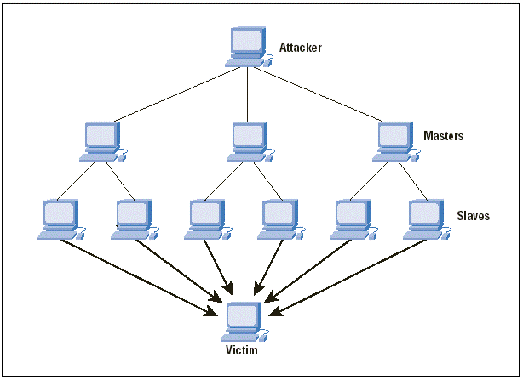
Denial of Service(DoS) attack.

Slide 5
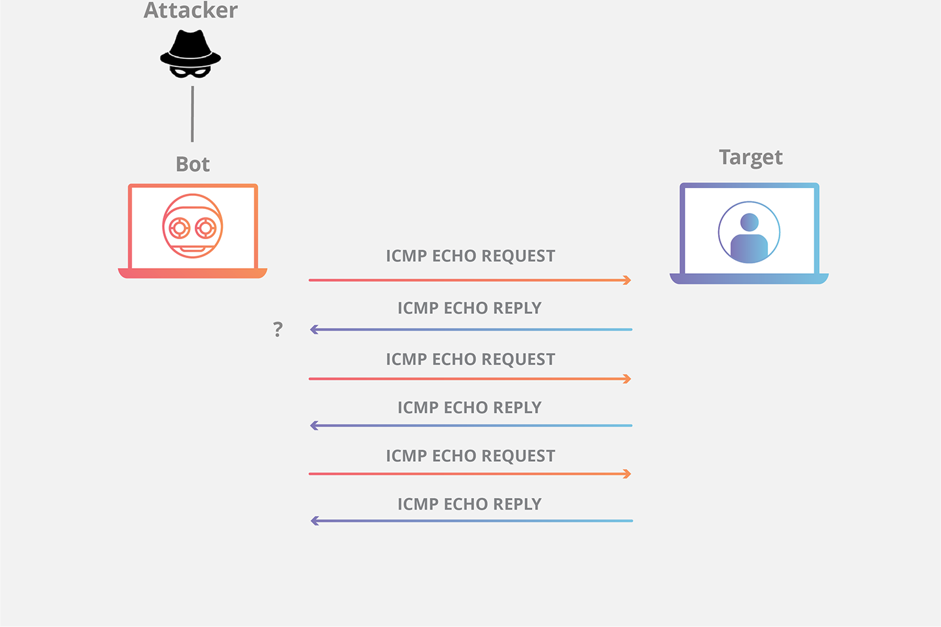
ICMP Flood Attack

Slide 6
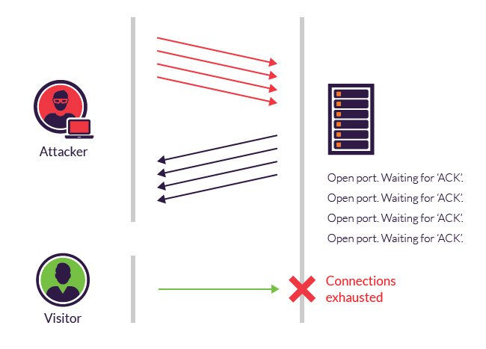
TCP – SYN flood Attack

Slide 7
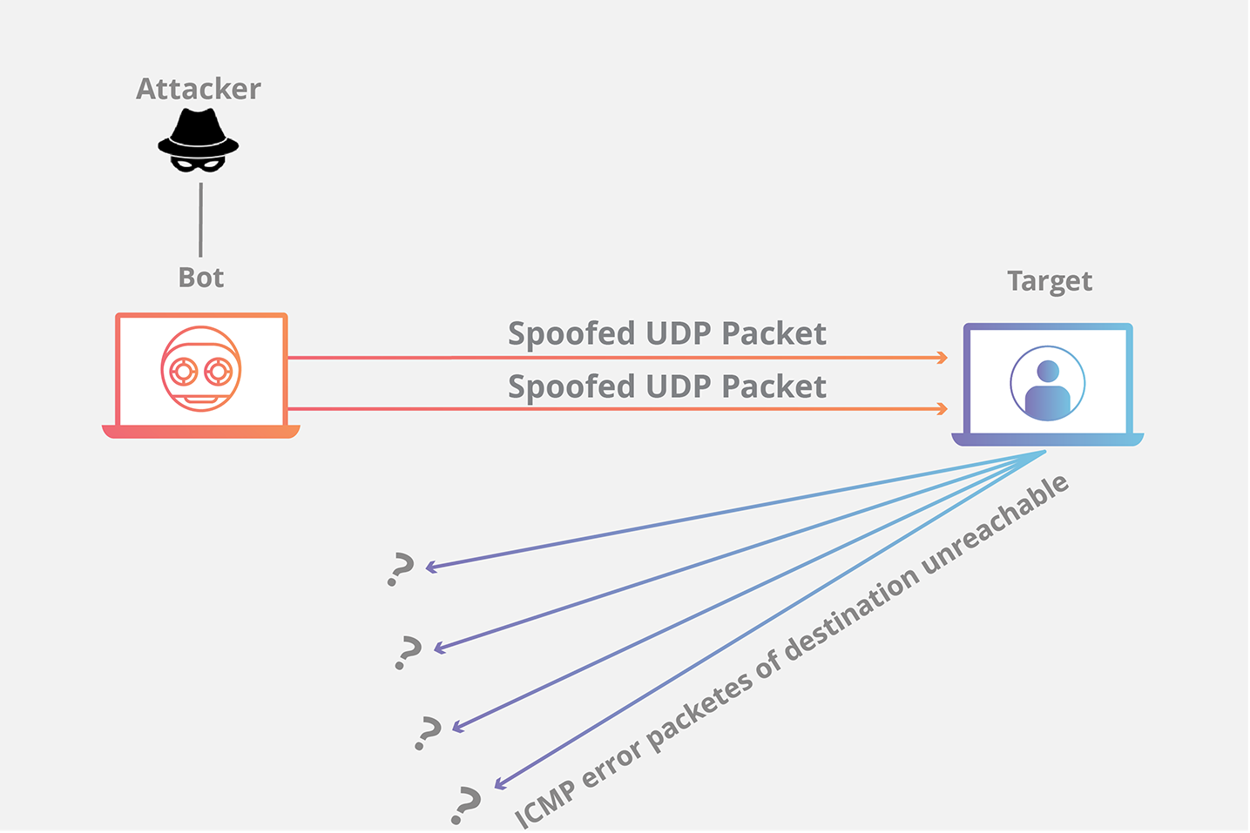
UDP flood Attack

Slide 8
Objective of this research :
Analyse
Analyse the data for its characteristic.
Develop
Develop Machine Learning models using Logistic Regression, Decision Tree, Multi-Layer Perceptron, K Nearest Neighbors and Light Gradient Boosting Machine.
Evaluate
Evaluate the model and predict the accuracy of the model for the detection of a DoS attacks.
Propose
Propose a model that detect the accuracy better or similar with compared to other models. Achieving a better model that can be used for detection of DoS attack in an efficient manner.

Slide 9
Major Contribution
The major contribution obtained from this research project is to use an efficient model that is Light Gradient Boosting Machine model for the detection of an DoS attack, as this work hasn’t been done before and there was an eagerness for a model that provides better accuracy and is light weighted which means it requires less memory, less processing and gives a better detection rate with less error. Light GBM provides fast processing with the capability to handle large datasets. And performs quite well in real time risk assessment.

Slide 10
Models Used
The Machine Learning algorithm that is discussed in this research project is Logistic Regression, Decision Tree, Multi-Layer Perceptron, K Nearest Neighbors and Light Gradient Boosting Machine.
The research project emphasis on the use of Light Gradient Boosting Machine algorithm for an efficient detection of DoS attack.
Light Gradient Boosting Machine model has a faster processing with high efficiency, requires less memory, can work easily with large datasets and provides better accuracy with compared to different algorithms.

Slide 11


Tools Used
Python is used to develop models and the entire code is written and debugged using python.
An open source tool known as Anaconda is used to manage and deploy python scripts.
The scripts are written in Jupyter Notebook, which is used to load the data, pre-process the data, build models and evaluate the results.
Using Jupyter Noteook models are built using Light Gradient Boosting Machine, Logistic Regression, K Nearest Neighbors Classifier, Multi-Layer Perceptron & Decision Tree.
The models are evaluated using various methods and the results are provided in visual format for a clear understanding.

Slide 12
Methodology
Data selection
Data pre-processing
Model Building & training
Evaluation

Slide 13
1. Data Selection
The research required a dataset that contains information that are required to detect a DDoS attack. One such dataset is available on public domain is KDD-CUP99 dataset. The dataset is well known for Intrusion detection techniques. The dataset was prepared and managed by MIT Lincoln Labs. The dataset has about 42 attributes which is used in this study. Dataset: https://datahub.io/machine-learning/kddcup99

Slide 14

2. Data Pre-processing
After the selection and importing of the dataset, now the data needs to be split into two types i.e. Train data and Test data. So that the data can be used in an efficient way. There are multiple things that are done to the data so that it can be used to transform the raw data in some useful and efficient format. The aim of pre-processing is to examine the data before mining. The steps that are included in pre-processing are as follows:
Split the data into Test and Train Data.
Add feature scaling to the Train data.

Slide 15
3. Model Building & Training
The model is built on the training data that is used to predict the accuracy of the Light Gradient Boosting Machine, Logistic Regression, K Nearest Neighbors Classifier, Multi-Layer Perceptron & Decision Tree.
The models are compared to come up with the algorithm that have the best predictions of the attack efficiently.
Accuracy totally depends upon what parameters you assign for a specific model. In order to perform predictions on the test data, the main parameters that are used to train the model depends upon the minimum amount of data in leaf, number of threads.

Slide 16
4. Evaluation
The metrics used in evaluation to analyse the models are:
Root Mean Squared Error (RMSE) - RMSE is the squared root of the difference between the expected value and the predicted value of the sample data
Mean Absolute Error (MAE) - MAE measures the average of magnitude error in prediction of the certain model.
R² - score is the measure of the accuracy performance of the regression model.
Confusion Matrix - The main benefit of confusion matrix is that it not only provides with the errors that are made by the classifier but also tells about the types of errors that are made by the classifier
Receiving Operating Characteristic (ROC) curve - is a plot of the False Positive rate on the x-axis versus True Positive rate on the y-axis of the data.

Slide 17

Demo

Slide 18
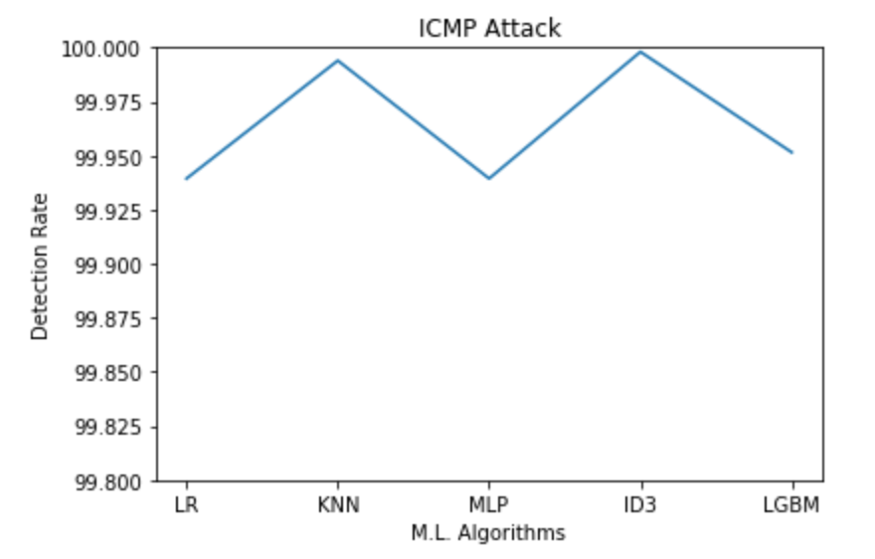
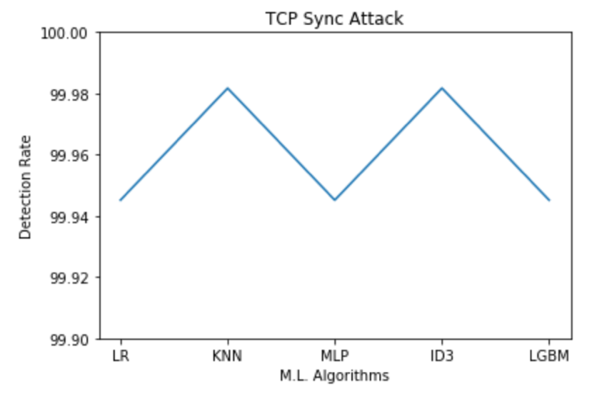
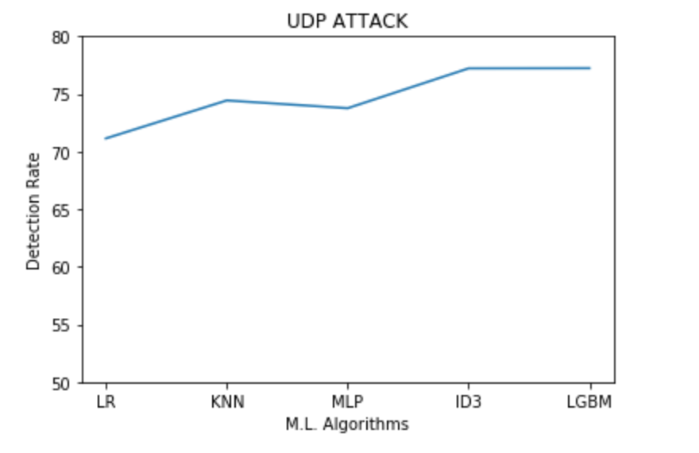
Results

Slide 19
Results evaluated in form of Tables
Models used | RMSE | MAE | R² | Accuracy
Light Gradient Boosting Machine | 0.022 | 0.000 | 0.773 | 99.9515
Logistic Regression | 0.025 | 0.001 | 0.716 | 99.9393
K Nearest Neighbors | 0.008 | 0.000 | 0.972 | 99.9939
Multi-Layer Perceptron | 0.015 | 0.000 | 0.896 | 99.9777
Decision Tree | 0.004 | 0.000 | 0.991 | 99.9979
Models used | RMSE | MAE | R² | Accuracy
Light Gradient Boosting Machine | 0.023 | 0.001 | -0.001 | 99.9451
Logistic Regression | 0.023 | 0.001 | -0.001 | 99.9451
K Nearest Neighbors | 0.014 | 0.000 | 0.666 | 99.9817
Multi-Layer Perceptron | 0.023 | 0.001 | -0.001 | 99.9451
Decision Tree | 0.014 | 0.000 | 0.666 | 99.9817

Slide 20
Conclusion
The models developed have promising results in predicting the detection of DoS attacks efficiency with the Light Gradient Boosting Machine model outperforming all other models by constantly predicting better for all the experiments conducted with different train and test split data. And the values obtained for RMSE, MAE and R2, ROC and Confusion Matrix is also acceptable
My most heartfelt thanks to my supervisor Dr. Vikas Sahni for his constant support and encouragement throughout the research work. I thank him immensely for the guidance he has offered since the very beginning. All the ideas he was willing to share with me were of great help in shaping this research work. I would like to thank National College of Ireland and the School of Computing for providing an opportunity for me to carry out this research work.

Slide 21

Thank You

